Slide 1


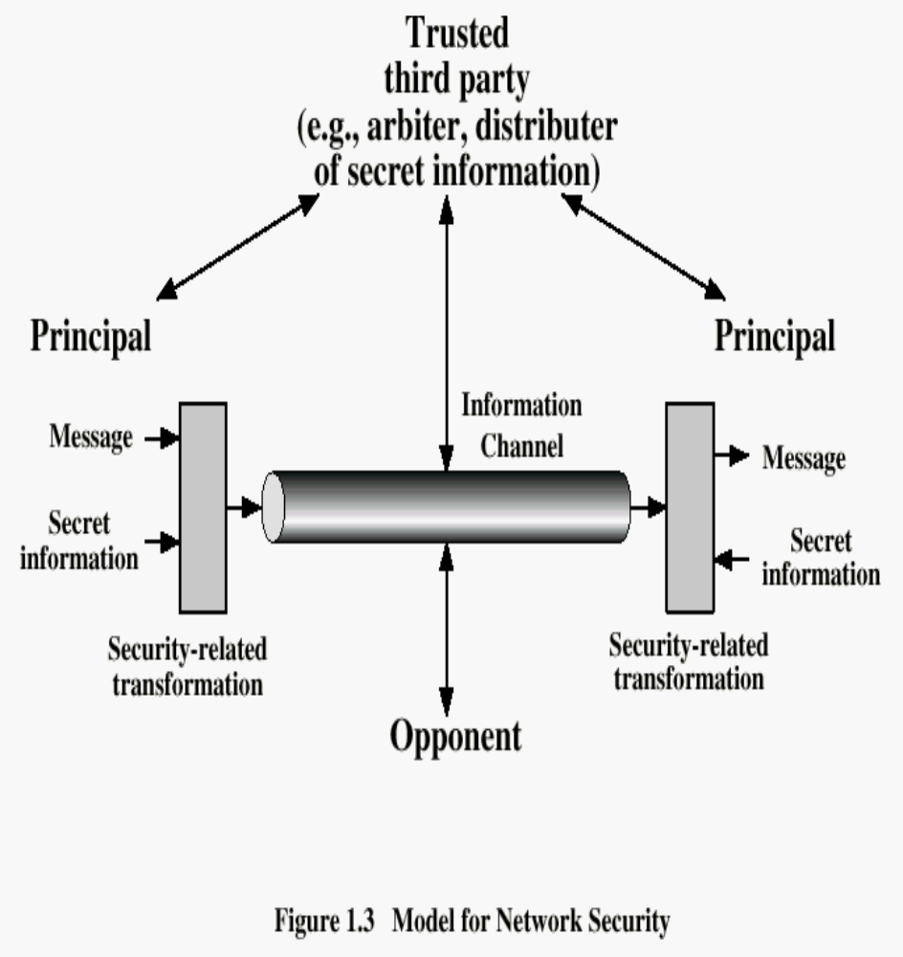
Introduction to Network Security
What is Security?
1. Freedom from risk or danger; safety.
2. Freedom from doubt, anxiety, or fear; confidence.
What is Network Security?
Security Attack: Any action that compromises the security of information.
Security Mechanism: A mechanism that is designed to detect, prevent, or recover from a security attack.
Security Service: A service that enhances the security of data processing systems and information transfers. A security service makes use of one or more security mechanisms.
z
Who is vulnerable?
Financial Institutions and Banks
Internet Service Providers
Pharmaceutical Companies
Government and Defense Agencies
Multinational Corporations
ANYONE ON THE NETWORK
Attacks, Services, Defense
Models | Elaboration
Security Attacks | Interruption: This is an attack on availability Interception: This is an attack on confidentiality. Modification: This is an attack on integrity. Fabrication: This is an attack on authenticity.
Security Services | Confidentiality Authentication Integrity Non-repudiation Access control Availability
Methods of Defense | Encryption Software Controls Hardware Controls Policies Physical Controls
Security Management
Security management involves protecting sensitive information on devices attached to a data network by controlling access points to that information.
Identify the sensitive
information to be protected
Finding the access points
Securing the access points
Maintaining the secure
access points
Security Goals
Confidentiality
Integrity
Availability
Internet standards and RFCs
IAB
IETF
IESG
Names: Madiha, Sobia, Samreen, Jahangeer Instructor: Asima Nisar

